Slide 1
CENTRAL PLACE THEORY
-Walter Christaller,1933
By
Dr. Chandana Singha
Head
Department of Geography
B.B. College, Asansol

Slide 2
INTRODUCTION
Central Place Theory (CPT) is an attempt to explain the spatial arrangement, size, and number of settlements.
The theory was originally published in 1933 by a German
geographer Walter Christaller who studied the settlement patterns in southern Germany.
In the flat landscape of southern Germany Christaller noticed that towns of a certain size were roughly equidistant.
By examining and defining the functions of the settlement
structure and the size of the hinterland he found it possible to model the pattern of settlement locations using geometric shapes.

Slide 3
EXPLANATION OF SOME TERMS
Central place: A Central Place is a settlement which provides one or more services for the population living around it.
Zone of influence: The sphere of influence is the area under influence of the Central Place.
Economic reach: This is a measure of centrality
Centrality: It is crucial to the development of urban places and their service areas.
Hinterland: It refers to the area surrounding a service from which consumers are drawn.
Central function: Services that are performed purely for the surrounding areas are termed central functions.

Slide 4
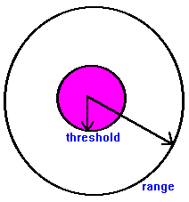
DETERMINANTS OF CENTRAL PLACE
Threshold Population_ Each Function needs a minimum number of customer to survive. The minimum population that can ensure this number is called its threshold population. Therefore the threshold population of a lower order function will be less than that for a higher order one.
Range of Function_ the average maximum distance people will travel to purchase goods and services
From these two concepts the lower and upper limits of goods or services can be found. With the upper and the lower limits, it is possible to see how the central places are arranged in an imaginary area.

Slide 5
ASSUMPTIONS
An even (flat) terrain – A hilly and uneven terrain poses difficulty in development thus a flat area which promotes the growth of the town
Evenly distributed population – residents are not concentrated at one particular place and no preference exists for a particular town
Evenly distributed resources – no place has an advantage of resources, all placed will compete under perfect market conditions
Similar purchasing power – along with the population and resources, wealth is also fairly distributed. Because of this people have similar purchasing power
Preference for the nearest market – people will buy products from the nearest market and avoid the long commute. This keeps price constant as per other assumptions
Equal transportation cost (proportional to distance) – the cost incurred in transporting of goods is equal for all and is proportional to the distance
Perfect competition – price is decided on basis of demand and supply. People will buy at the lowest price which market has to offer, no seller has an advantage over another seller.

Slide 6
HIERARCHY OF SETTLEMENTS
SMALL TOWNS
VILLAGE
HAMLET
LARGE TOWNS
CITY
CAPITAL
Markets and Services tend to be nested hierarchies with smaller towns serving smaller markets. However, transportation and border effects can shift the distribution of towns away from theoretical uniformity.

Slide 7
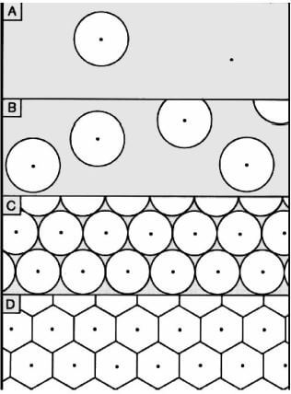
ARRANGEMENTS OF CENTRAL PLACES
Circular shape of the market areas results in either un-served areas or
over-served areas. To solve this problem, Christaller suggested the hexagonal shape of the markets as shown in D in the above diagram.

Slide 8
THREE PRINCIPLES FOR ARRANGEMENTS OF CENTRAL PLACES
1.The marketing principle (K=3 system)
2. The transportation principle (K=4 system);
3. The administrative principle (K=7 system).

Slide 9
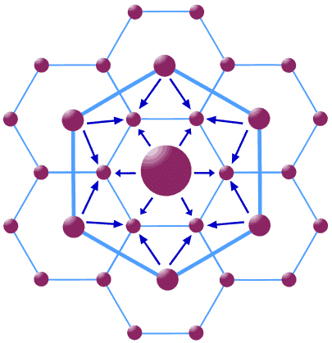
MARKETING PRINCIPLE
Marketing Principle (K=3): As per this the market area of a higher order occupies one-third (1/3 part) of the market area of each of the consecutive lower size place(node) which lies on its neighbor. The lower size nodes (6 in numbers and 2nd larger circles) are located at the corner of the largest hexagon around the high-order settlement. Each high-order settlement gets 1/3rd of each satellite settlement (which are 6 in total), thus K = 1 + 6×1/3 = 3.
With K=3 the transport network is not efficient even when the distance traveled is reduced. This is because of the absence of transport links (network) between the larger places (nodes).

Slide 10
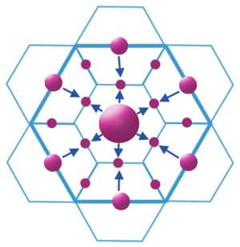
TRANSPORT PRINCIPLE
Transport Principle (K=4): This provides for most efficient transport network. High order place half of the market area of 6 neighboring lower order places located on the edge of the hexagon formed by high order settlement. There are maximum central places possible. These are located on the main transport routes connecting the higher order center. The transportation principle involves the minimization of the length of roads connecting central places at all hierarchy levels. In this system of nesting, the lower order centers are all located along the roads linking the higher order centers. This alignment of places along a road leads to minimization of road length. However, for each higher order center, there are now four centers of immediate lower order, as opposed to three centers under the marketing principle.

Slide 11

ADMINISTRATIVE PRINCIPLE
Administrative Principle (K=7): According to K = 7 administrative principle (or political-social principle), settlements are nested according to sevens. The market areas of the smaller settlements are completely enclosed within the market area of the larger settlement. Since tributary areas cannot be split administratively, they must be allocated exclusively to a single higher-order place. Efficient administration is the control principle in this hierarchy.

Slide 12
EVALUATION
The pattern of cities predicted by central place theory may not hold because of the failure to meet initial assumptions.
Production costs may vary not only because of economies of scale but also by natural resource endowments (i.e. not a homogeneous plain).
Transportation costs are not equal in all directions.
Rural markets (initially households) are not evenly distributed.
Non economic factors (culture, politics, leadership) may be important but not evenly distributed.
Competitive practices may lead to freight absorption and phantom freight (other forms of imperfect competition).

